Slide 1
Box Platform Developer Workshop Cummins
Jonathan LeBlanc
Director of Developer Advocacy, Box
Twitter: @jcleblanc
Github: https://github.com/jcleblanc

Slide 2
User Types, Application Auth Types, and Scopes

Slide 3
Users Types

Slide 4



Types of Users Defined within Box
App User
Managed User
External User
Users created by an app that may only be accessed by that app. This user account can only be accessed through API calls.
A regular Box user that is part of the same enterprise as the app. This user account can be accessed by the API or by logging in to box.com
Same as a managed user, but is not part of the same enterprise as the app. These are users that have been collaborated into content by a user in the enterprise.

Slide 5
Application Auth Types

Slide 6



Types of Auth Systems Box Platform Employs
OAuth 2
JWT / OAuth 2
Developer Token
Use a user’s Box login as the identity system
Use an existing identity system without logging into Box
Short lived developer prototyping token

Slide 7
OAuth 2
User types: Managed users.
Requires that users be forwarded to Box to log in with their Box account to accept app permissions.
Access token that is generated is bound to the user who logged in.

Slide 8

JWT / OAuth 2
User types: Managed and app users.
Allows the use of an existing identity management system.
Allows the app to manage all user and config content.
Runs behind the scenes.

Slide 9
Developer Token
User types: None.
Short lived (1 hour) token generated in the application config.
Cannot be refreshed programmatically, only manually.
Should only be used for quick testing & API requests, never in production.

Slide 10
Scopes

Slide 11
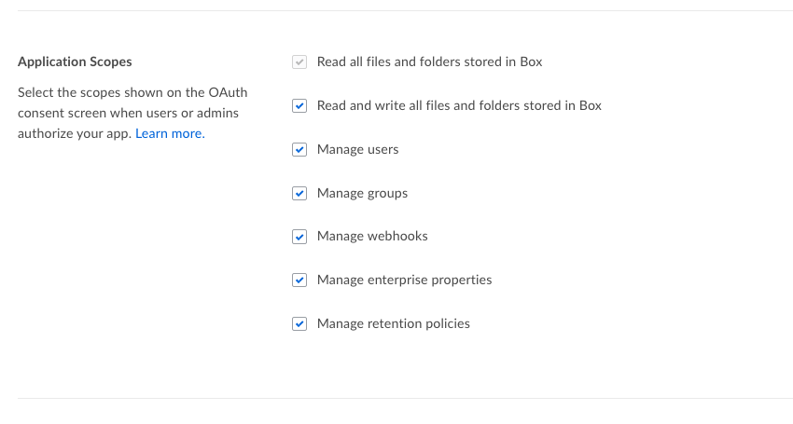
Application Scopes
What your application will have permission to do on behalf of the application, enterprise, and users.

Slide 12
Read / Write Files & Folders
Upload / View / Download files and folders, and update file versions.
Create / Read / Update / Delete collaborations, tags, tasks, comments, @mentions, task assignments, notifications, and collections.
View enterprise profile information.

Slide 13
Manage Users
Create / Read / Update / Delete / Activate / Disable Users (app and managed).
Change primary login, reset password, change role for managed users and enterprise content.

Slide 14
Manage Groups
Create / Read / Update / Delete groups and group memberships for users.

Slide 15
Manage Webhooks
App can programmatically control webhooks (referred to as webhooks v2).
Create / Read / Update / Delete new or existing webhooks on files and folders.

Slide 16
Manage Enterprise Properties
Read / Update enterprise attributes and reports.
Edit / Delete device pinners (what devices can use native Box applications).

Slide 17
Manage Retention Policies
Create / Read / Update data retention policies.
Feature is tied to Box Governance service package.

Slide 18
Links and Code Samples

Slide 19
Code Samples
Authentication and Authorization (JWT / OAuth2)
Creating a JWT app client with the downloaded Box application config file https://github.com/jcleblanc/box-workshops/blob/master/app-auth/jwt-auth-config.js
Creating a JWT app client with manually created public/private keys: https://github.com/jcleblanc/box-workshops/blob/master/app-auth/jwt-auth-keys.js
Manually constructing the JWT claims process (no SDK): https://github.com/jcleblanc/box-examples/blob/master/node/samples/auth_jwt_api.js

Slide 20
Code Samples
User Management
Create a new app user: https://github.com/jcleblanc/box-workshops/blob/master/app-auth/create-app-user.js
Create a new managed user: https://github.com/jcleblanc/box-workshops/blob/master/app-auth/create-managed-user.js
Delete a user by ID: https://github.com/jcleblanc/box-workshops/blob/master/app-auth/delete-user.js

